Slide 1
TechShoi
Database
Application
Updated
Check for this
Ahammad Shawki

Slide 2
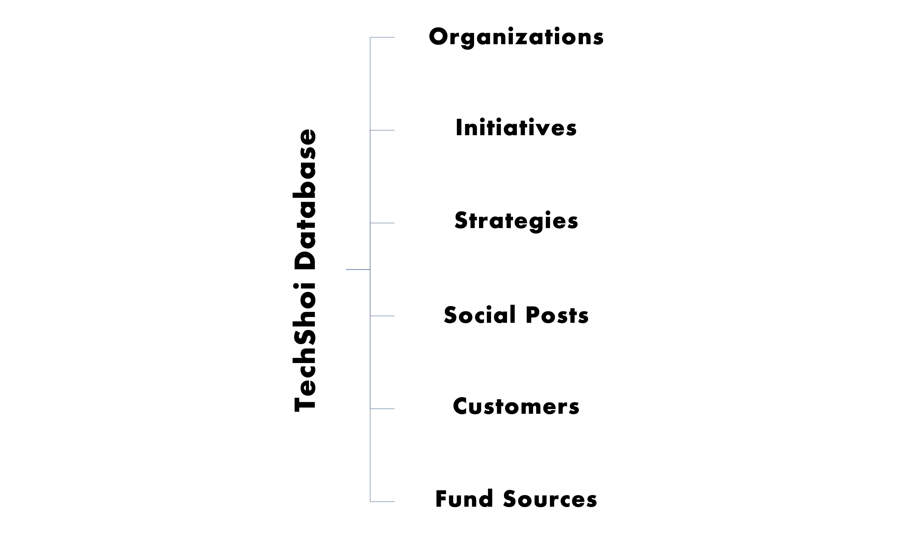
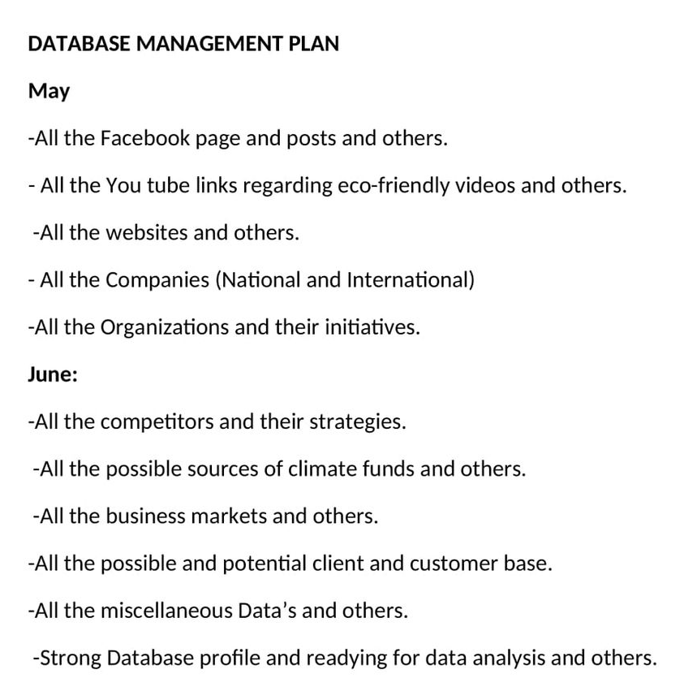
Fulfilling Requirements
Consumer
Tables - Requirements Plan

Slide 3
Tables
Columns
Relationships
Plan.

Slide 4
Databases & Tables
Database = 2
Authentication Database
Authentication Tables = 2
Core Database
Old Tables = 6
New Tables = 2

Slide 5
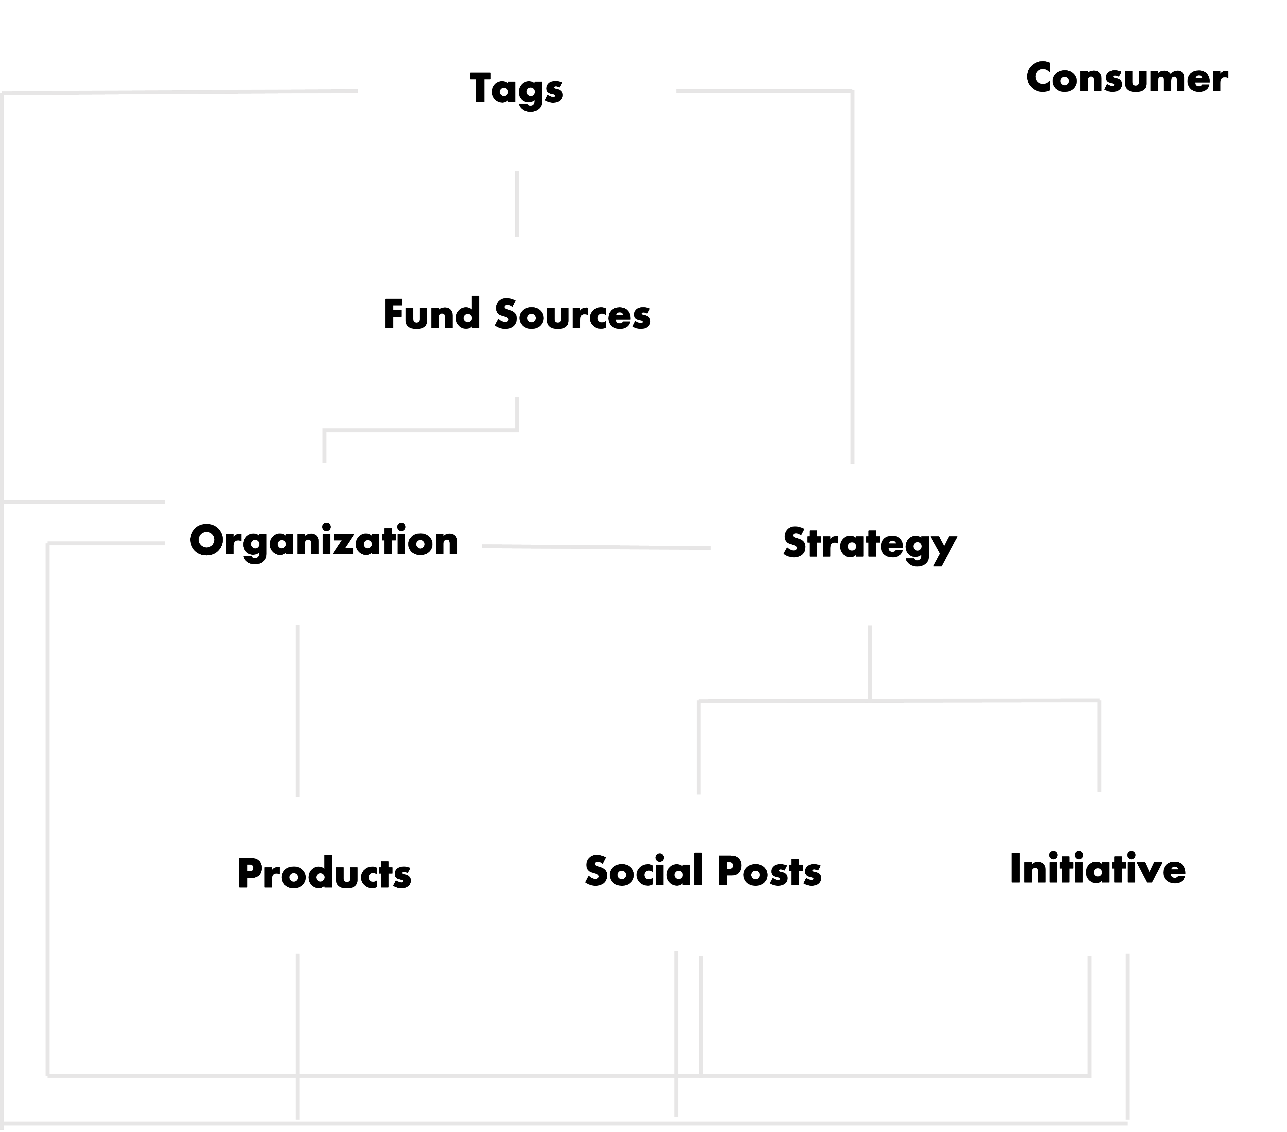
Tables Dependency Chart

Slide 6
New Table
Tags
Id | UUID, PRIMARY KEY, NOT NULL
Value | CHARFIELD(MAX_LENGTH = 50), NOT NULL
Search Filter
Value
List Filter
-

Slide 7
Fund Sources
Id | UUID, PRIMARY KEY, NOT NULL
Name | CHARFIELD(MAX_LENGTH=100), NOT NULL
Location | CHARFIELD(MAX_LENGTH=100), NOT NULL
Email | EMAIL_FIELD, UNIQUE CONSTRAINT, NOT NULL
Site | URL_FIELD, NOT NULL
Funding Possibility | SELECT_FIELD (Low | Medium | High), NOT NULL
Tags | MANY-TO-MANY RELATIONSHIP, NULL
Search Filter
Name, Location, Email, Site
List Filter
Funding Possibility, Tags

Slide 8
Organizations
Id | UUID, PRIMARY KEY, NOT NULL
Name | CHARFIELD(MAX_LENGTH=100), NOT NULL
Location | CHARFIELD(MAX_LENGTH=100), NOT NULL
Category | SELECT_FIELD (COMPETITOR | NEUTRAL | MARKET | VENDORS), NOT NULL
Email | EMAIL_FIELD, UNIQUE CONSTRAINT, NULL
Site | URL_FIELD, NULL
Status | SELECT_FIELD(ACTIVE | INACTIVE), NOT NULL
Funder | MANY-TO-MANY RELATIONSHIP, NULL
Tags | MANY-TO-MANY RELATIONSHIP, NULL
Search Filter
Name, Location, Email, Site
List Filter
Category, Status, Funder, Tags

Slide 9
Strategies
Id | UUID, PRIMARY KEY, NOT NULL
Name | TEXT_FIELD, NOT NULL
Organization | FOREIGN KEY, NULL
Tags | MANY-TO-MANY RELATIONSHIP, NULL
Search Filter
Name
List Filter
Organization, Tags

Slide 10
Initiatives
Id | UUID, PRIMARY KEY, NOT NULL
Name | TEXT_FIELD, NOT NULL
Date | DATEFIELD, NULL
Link | URL_FIELD, NULL
Organization | FOREIGN KEY, NOT NULL
Strategy | MANY TO MANY RELATIONSHIP
Tags | MANY-TO-MANY RELATIONSHIP, NULL
Search Filter
Name, Link
List Filter
Date, Organization, Strategy, Tags

Slide 11
Social Posts
Id | UUID, PRIMARY KEY, NOT NULL
Platform | CHARFIELD(MAX_LENGTH=100), NOT NULL
Date | DATEFIELD, NULL
Link | URL_FIELD, NOT NULL
Organization Id | FOREIGN KEY, NOT NULL
Strategy Id | MANY-TO-MANY RELATIONSHIP, NOT NULL
Tags | MANY-TO-MANY RELATIONSHIP, NULL
Search Filter
Link
List Filter
Platform, Date, Organization, Strategy, Tags

Slide 12
New Table
Products
Id | UUID, PRIMARY KEY, NOT NULL
Name | CHARFIELD(MAX_LENGTH = 100), NOT NULL
Price | INTEGER FIELD, NOT NULL
Date | DATEFIELD, NULL
Features | TEXT_FIELD, NOT NULL
Link | URL_FIELD, NULL
Organization Id | FOREIGN KEY, NOT NULL
Tags | MANY-TO-MANY RELATIONSHIP, NULL
Search Filter
Name, Features, Link
List Filter
Price, Date, Organization, Tags

Slide 13
Consumer
Id | UUID, PRIMARY KEY, NOT NULL
Name | CHARFIELD(MAX_LENGTH = 100), NOT NULL
Email | EMAIL_FIELD, UNIQUE CONSTRAINT, NULL
Age | INTEGER_FIELD, NOT NULL
Location | TEXT_FIELD, NULL
Social Link | URL_FIELD, NULL
Search Filter
Name, Email, Location, Social Link
List Filter
Age

Slide 14
Data Entry Rules
Location
Dhaka, Bangladesh
Delhi, India
d

Slide 15
DATA
ANALYSIS &
VISUALIZATION
Plan.

Slide 16
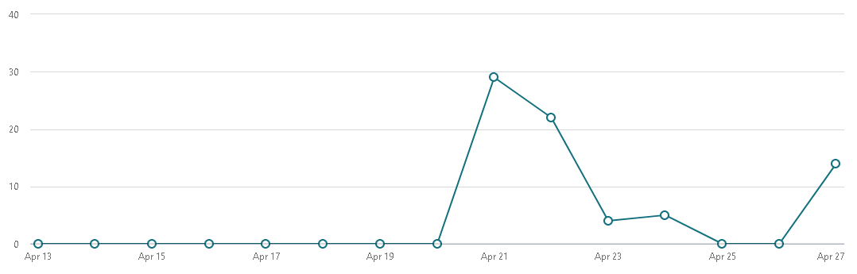
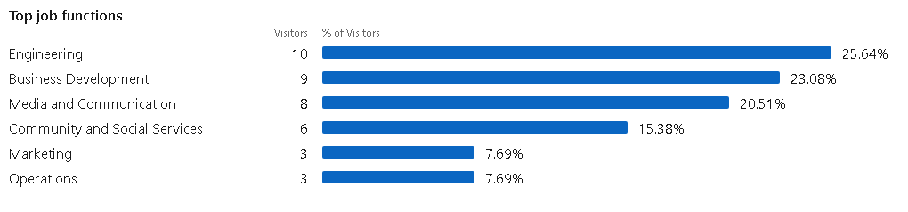
SOME EXAMPLES
LinkedIn

Slide 17
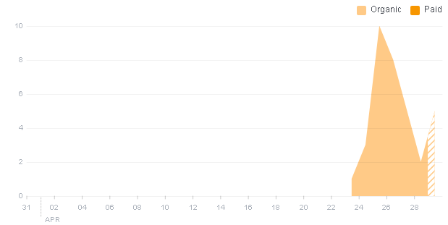
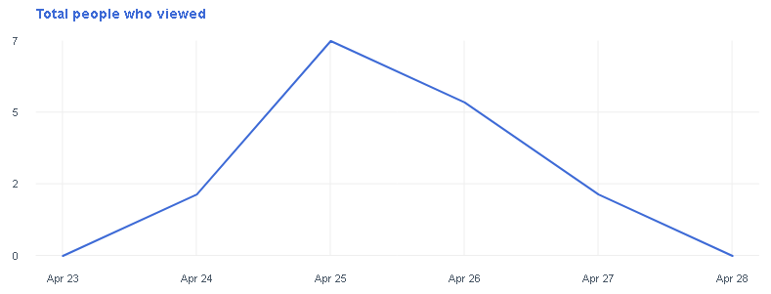
Facebook

Slide 18
Data Analysis Ideas
Fund Sources Location (Bar)
Fund Sources Funding Possibility (Pie)
Organization Location (Bar)
Organization Category (Pie)
Organization Status (Pie)
Social Post Platforms (Pie)
Product Price (Hist)
Consumer Location (Bar)
Consumer Age (Hist)

Slide 19
Implementations
UIUX

Slide 20


Home Page

Slide 21
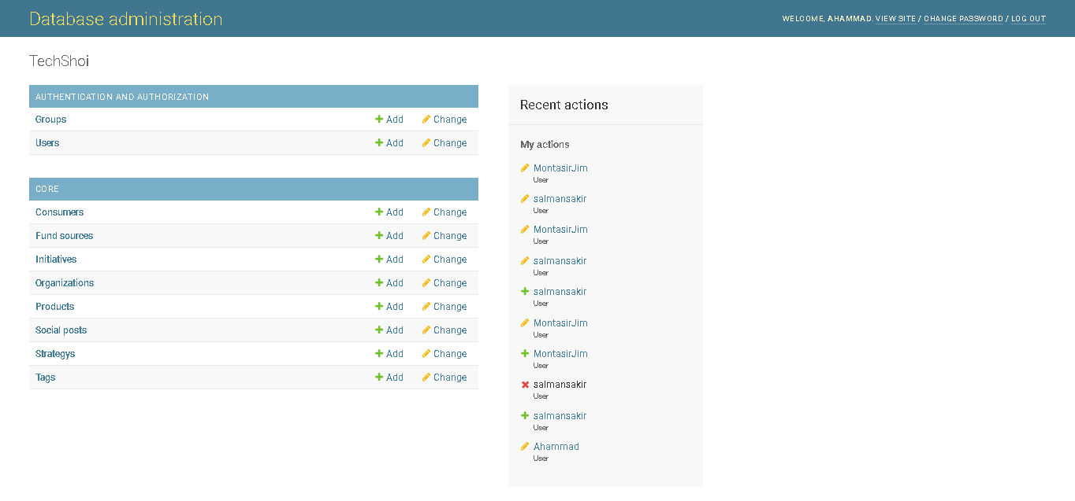
Admin Page

Slide 22
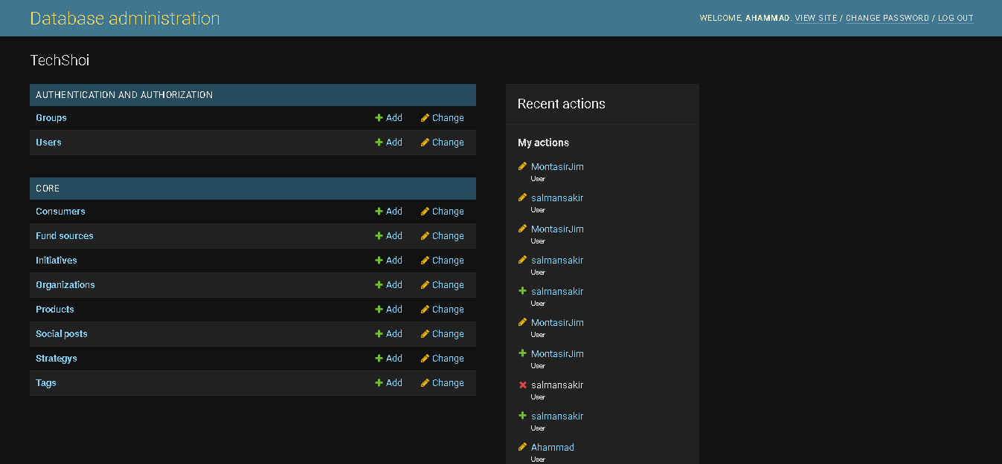
Admin Page

Slide 23
Admin Page

Slide 24
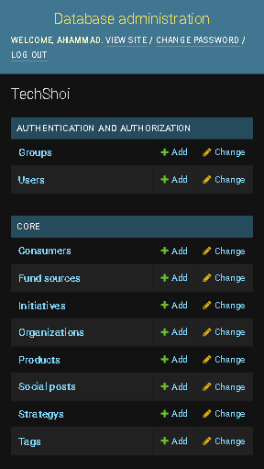
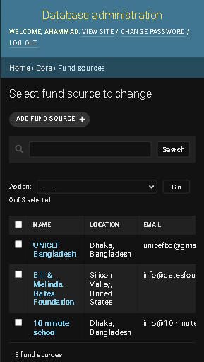
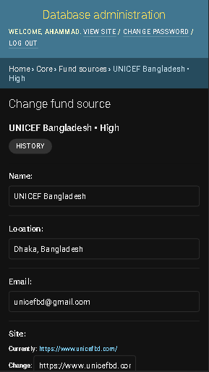
Admin Page

Slide 25

Analytics Page

Slide 26
Quick Recap
Features
Access data easily ✔
User friendly interface ✔
Customizable with-comment code ✔
Universally unique identifiers ✔
Backup data in excel sheets ✔
Data analysis support
4 layered Security Measurements ✔
Responsive Web Application ✔
Data Entry Focused Application ✔
Bug Report ✔
Dark Theme Admin Site ✔

